Slide 1
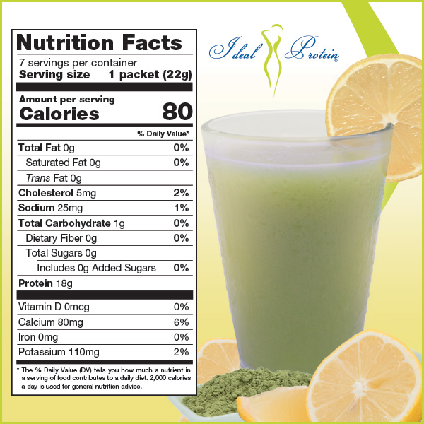
Available Individually
NEW
Lemon Matcha Green Tea
For all phases
Try it today at…

